Slide 1
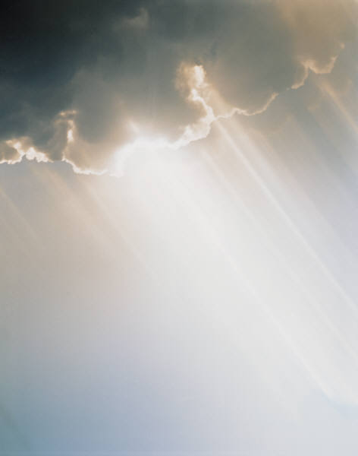
A Stormproof RELIGION
Matthew 7:24-27
(2)
All verses are from the NKJV unless noted.

Slide 2
Previously:
Matthew 7:24-27
Noted difference between the wise and foolish builder
The connection to Matthew 7:21-23
The relationship that exists between
  SAYINGS of Jesus and the WILL of the Father
  OBEDIENCE and ENTRANCE INTO KINGDOM
  KINGDOM and FORGIVENESS OF SINS
The result from doing the will of God = abiding forever! How and why?

Slide 3
Some Storms To Build Against
Storms of Deceit (Ezek. 13:1-16)
  Preach out of their heart rather than what
  came from God (13:2)
  Hope their word is confirmed (13:6)
  Is nonsense and lies (13:8)
  The storm is coming against their wall (13:10-16)
14 that we should no longer be children, tossed to and fro and carried about with every wind of doctrine, by the trickery of men, in the cunning craftiness of deceitful plotting,
15 but, speaking the truth in love, may grow up in all things into Him who is the head—Christ” (Eph. 4:14, 15)

Slide 4
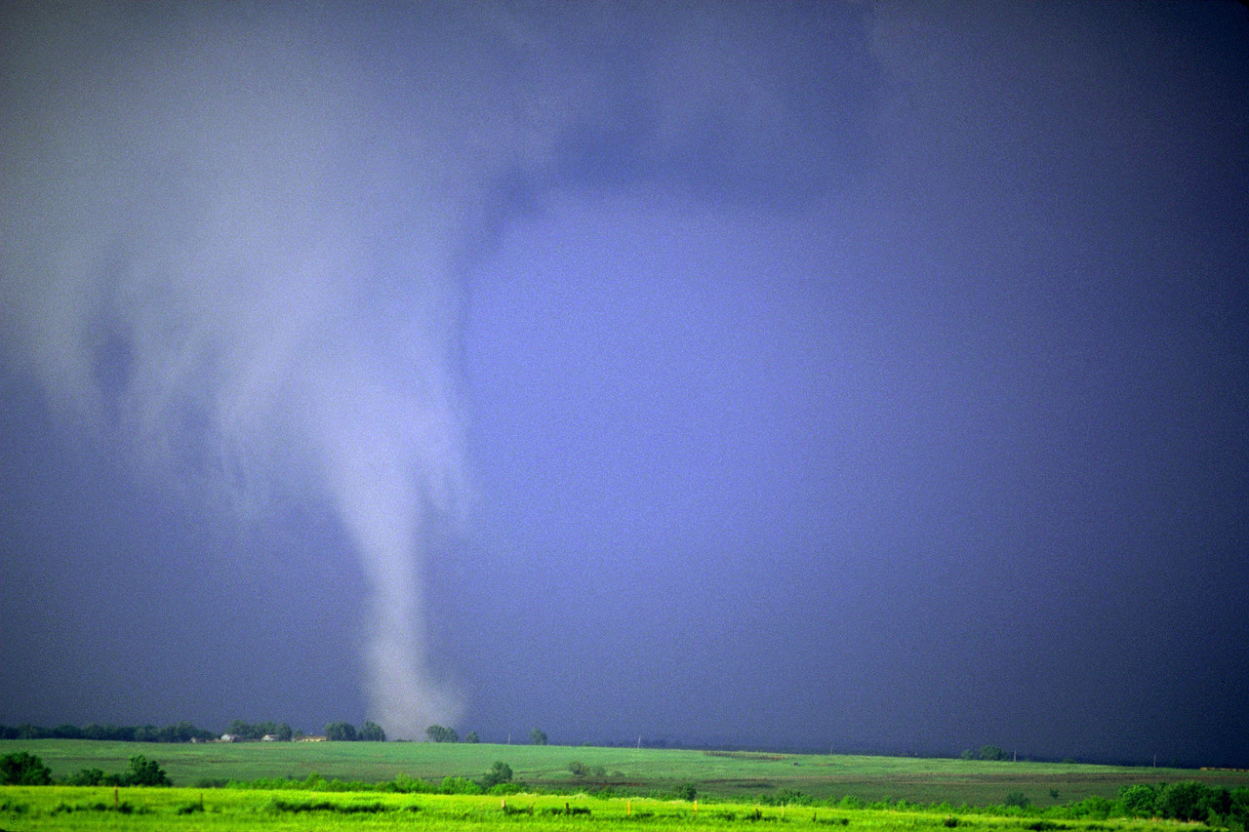
Some Storms To Build Against
Storms of Trial
  Job’s family, “and suddenly a great wind came from across the wilderness and struck the four corners of the house, and it fell on the young people, and they are dead; and I alone have escaped to tell you!“ (Job 1:19)

Slide 5
Some Storms To Build Against
Storms of Trial
  Job’s response, “Then Job arose, tore his robe, and shaved his head; and he fell to the ground and worshiped. And he said: ‘Naked I came from my mother’s womb, And naked shall I return there. The LORD gave, and the LORD has taken away; Blessed be the name of the LORD’” (Job 1:20, 21)

Slide 6
Some Storms To Build Against
Storms of Trial
  Do not need to bear these trials alone (2 Sam. 22:1-7)
  “Trust in Him at all times, you people; Pour out your heart before Him; God is a refuge for us. Selah” (Ps. 62:8)

Slide 7
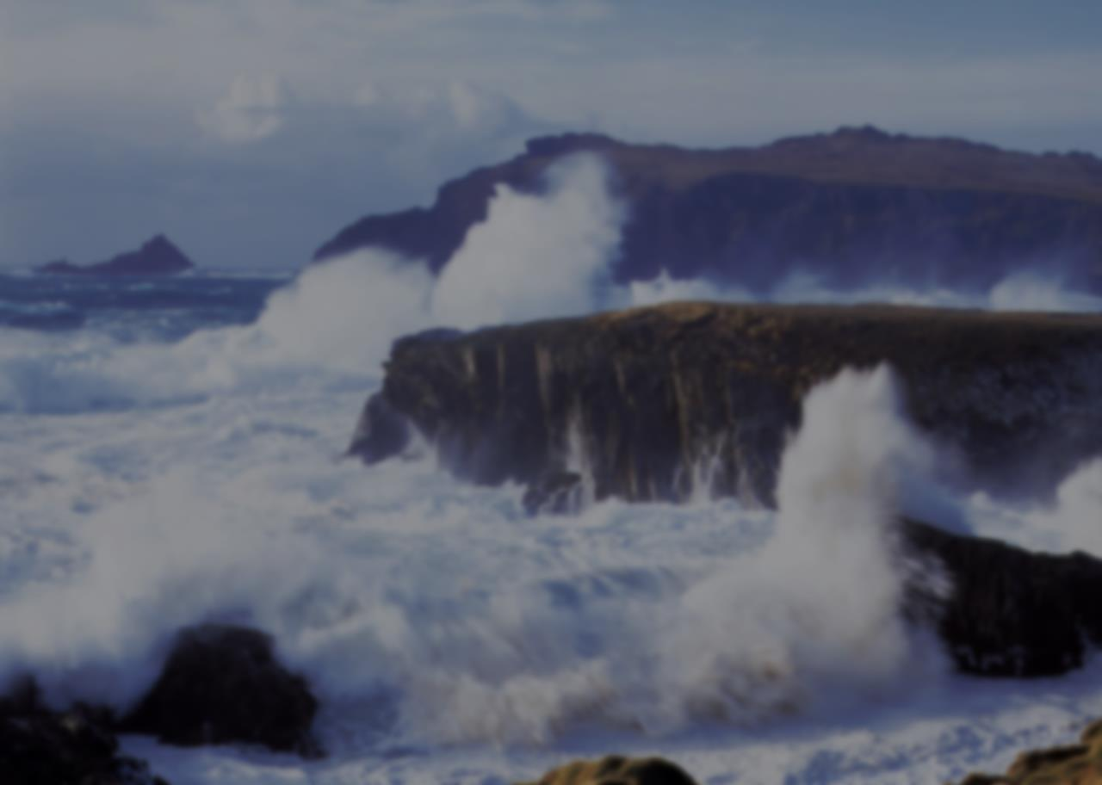
Some Storms To Build Against
Storms of Doubt (Mk. 4:37-40)
  ³⁷ And a great windstorm arose, and the waves beat into the boat, so that it was already filling.
  ³⁸ But He was in the stern, asleep on a pillow. And they awoke Him and said to Him, "Teacher, do You not care that we are perishing?"
  ³⁹ Then He arose and rebuked the wind, and said to the sea, "Peace, be still!" And the wind ceased and there was a great calm.
  ⁴⁰ But He said to them, "Why are you so fearful? How is it that you have no faith?"

Slide 8
Some Storms To Build Against
Do you have faith in:
  “Yea, though I walk through the valley of the shadow of death, I will fear no evil; For You are with me; Your rod and Your staff, they comfort me” (Ps. 23:4)
  “No temptation has overtaken you except such as is common to man; but God is faithful, who will not allow you to be tempted beyond what you are able, but with the temptation will also make the way of escape, that you may be able to bear it”
  (1 Cor. 10:13)

Slide 9
Some Storms To Build Against
Do you have faith in:
  “For if we believe that Jesus died and rose again, even so God will bring with Him those who sleep in Jesus” (1 Thess. 4:14)
  “There is one body and one Spirit, just as you were called in one hope of your calling; one Lord, one faith, one baptism; one God and Father of all, who is above all, and through all, and in you all” (Eph. 4:4-6)

Slide 10
Some Storms To Build Against
Do you have faith in:
  “But the cowardly, unbelieving, abominable, murderers, sexually immoral, sorcerers, idolaters, and all liars shall have their part in the lake which burns with fire and brimstone, which is the second death”
  (Rev. 21:8)
  “And having been perfected, He became the author of eternal salvation to all who obey Him” (Heb. 5:9)

Slide 11
Some Storms To Build Against
Do you have faith in:
  “Truly, these times of ignorance God overlooked, but now commands all men everywhere to repent” (Acts 17:30)
  “because He has appointed a day on which He will judge the world in righteousness by the Man whom He has ordained. He has given assurance of this to all by raising Him from the dead” (Acts 17:31)

Slide 12
Some Storms To Build Against
Do you have faith in:
  “…And I will give to each one of you according to your works” (Rev. 2:23)
  “He who shall believe, and be immersed, shall be saved; but he who shall not believe, shall be condemned” (Mk. 16:16, LO)
  “For yet a little while, And He who is coming will come and will not tarry. Now the just shall live by faith; But if anyone draws back, My soul has no pleasure in him” (Heb. 10:37, 38)

Slide 13
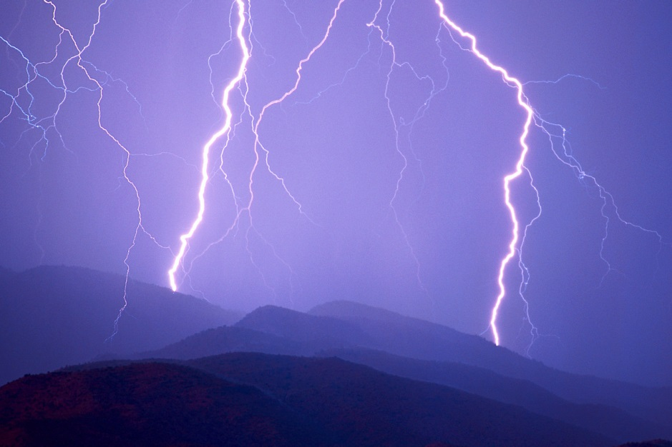
WILL YOU BEGIN BUILDING A STORMPROOF RELIGION TODAY?

